Slide 1
Storage devices that we use

Slide 2
About the author
Grishutenko Pavel
Student ICE 2 course
The Herzen State Pedagogical University of Russia
Email: example@mail.com

Slide 3
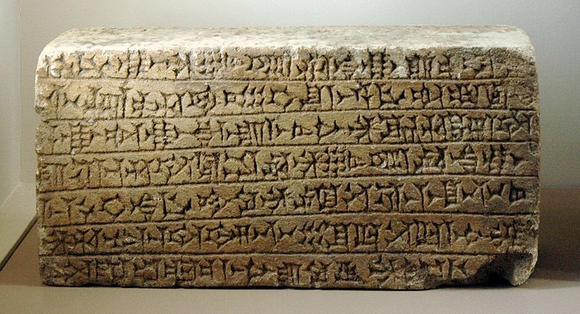
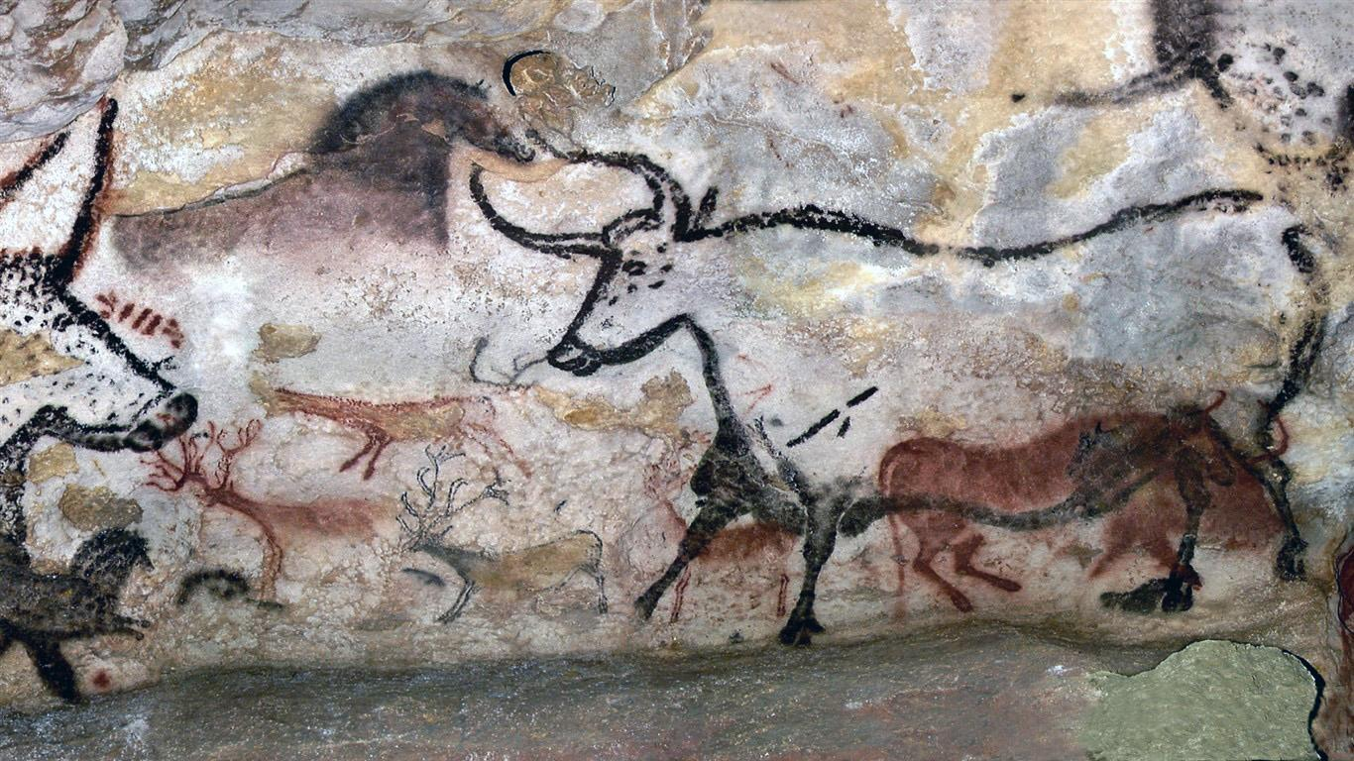

First storage devices

Slide 4
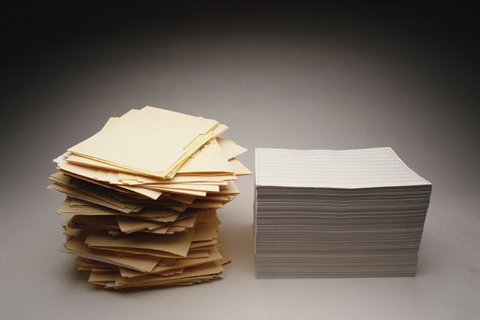
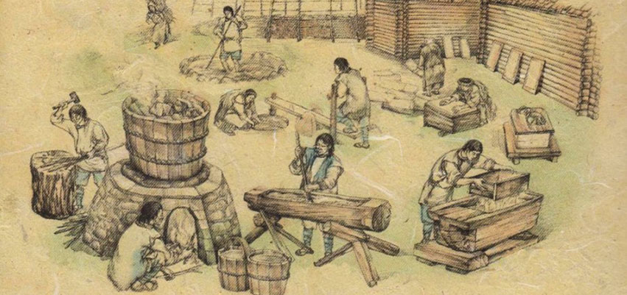
Paper - world-changing invention
ancient paper mill
Paper

Slide 5


How we use information
Information is used to make decisions. The ability to communicate, i.e., to exchange information becomes one of the main human skills in the modern world

Slide 6
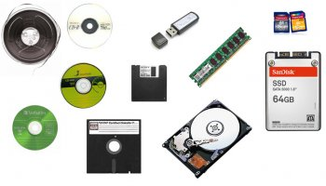
What is Digital Data Storage
The invention of the computer gave us a new way to interact with information

Slide 7
Digital Data Storage Devices:
Hard Drive Disk
Floppy Disk
Tape
Compact Disc (CD)
DVD and Blu-ray Discs
USB Flash Drive
Secure Digital Card (SD Card)
Solid State Drive (SSD)
Cloud Storage
Punch Card

Slide 8
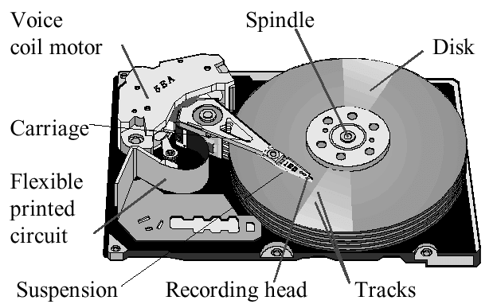
Hard Disk Drive

Slide 9
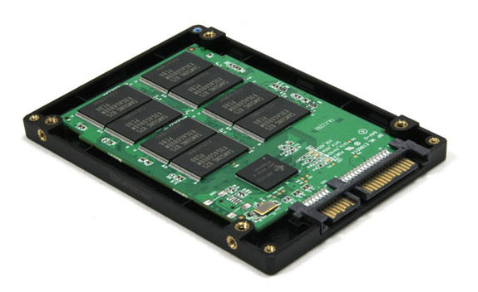
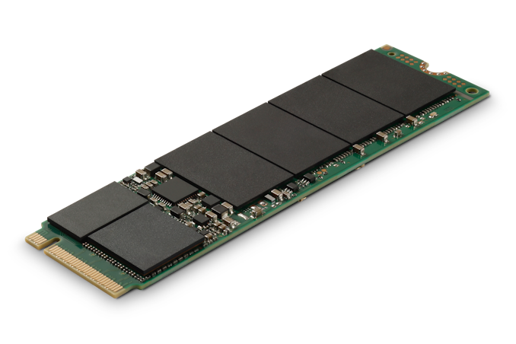
Solid state drive

Slide 10
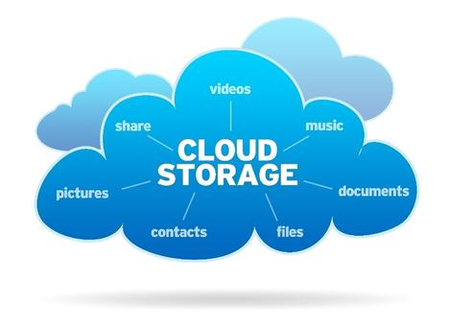
Cloud storages and Data centers

Slide 11
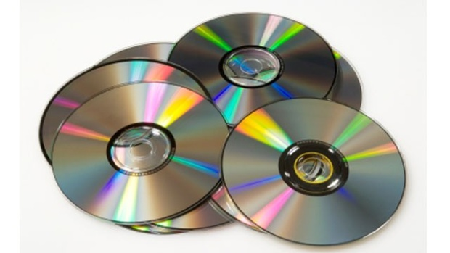
Compact Disc

Slide 12
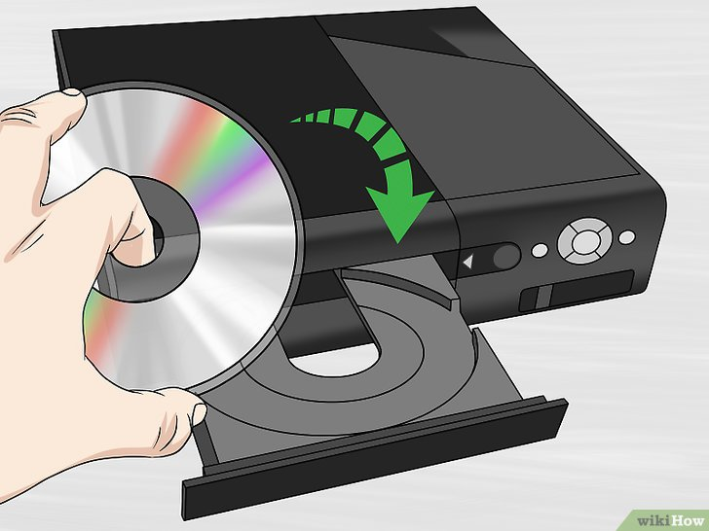
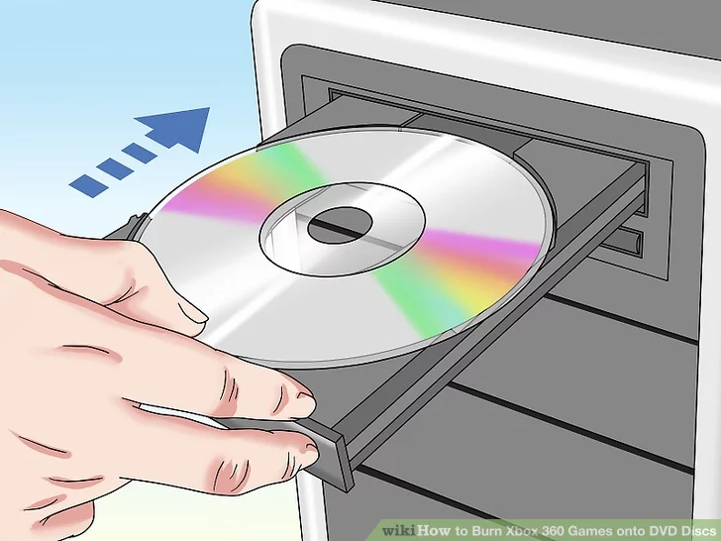
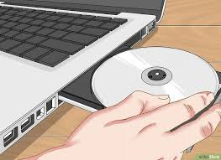
DVD and Blu-ray Discs

Slide 13
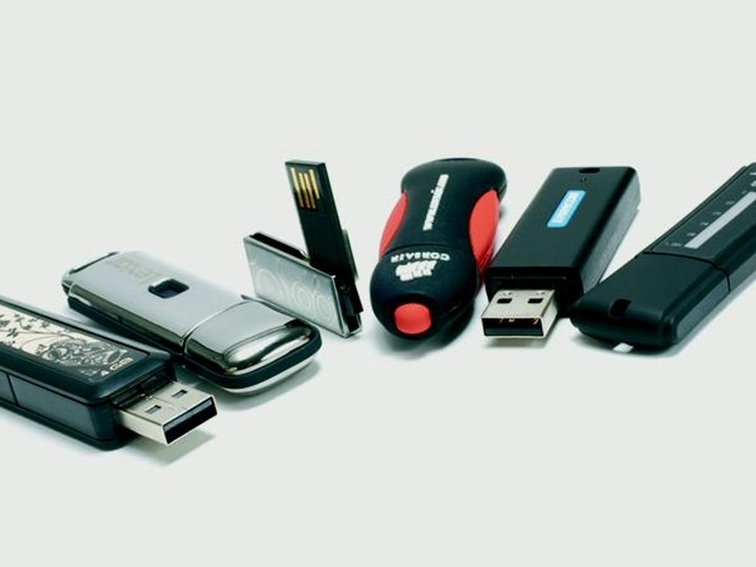
USB Flash Drive

Slide 14
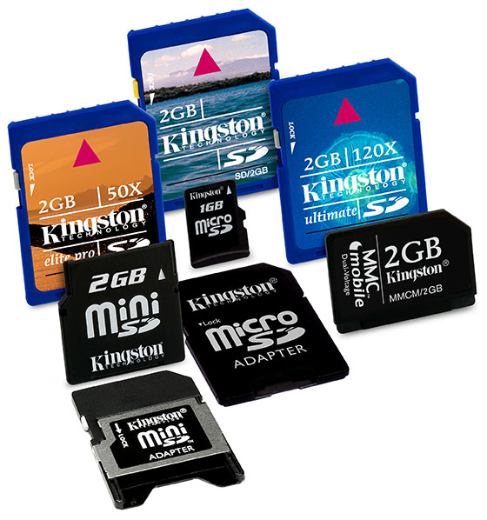
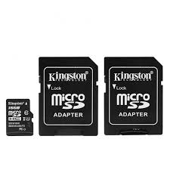
Secure Digital Card

Slide 15
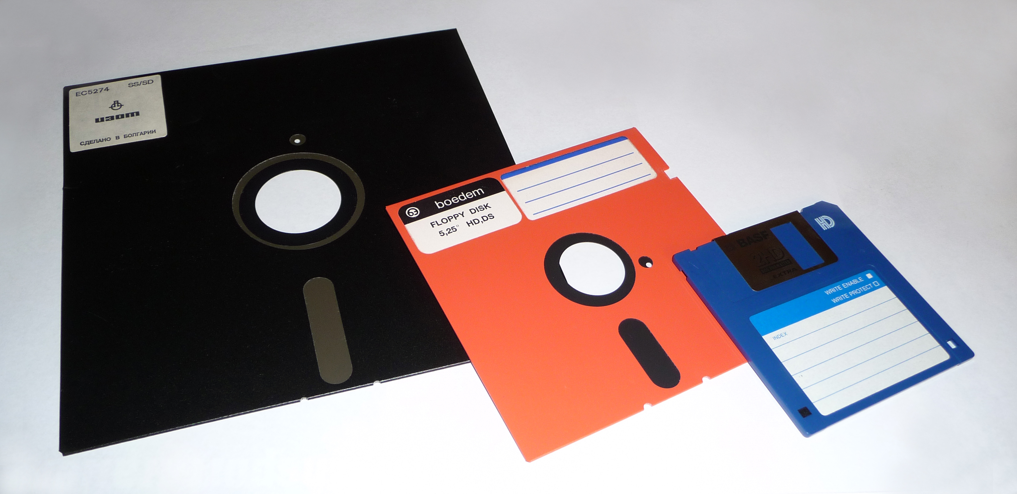
Floppy Disk

Slide 16
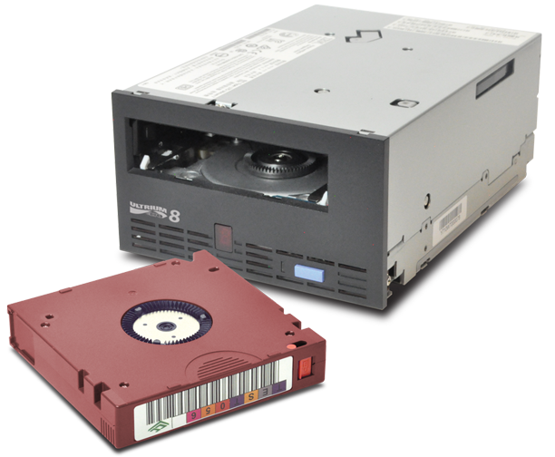
Tape

Slide 17
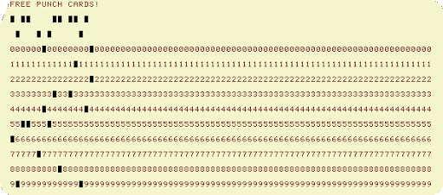
Punch Card

Slide 18

Future information storage
What do you think, how will we store information in the future?

Slide 19
«Storing information is what has changed our lives.»

Slide 20
Thank you for watching

